Slide 1
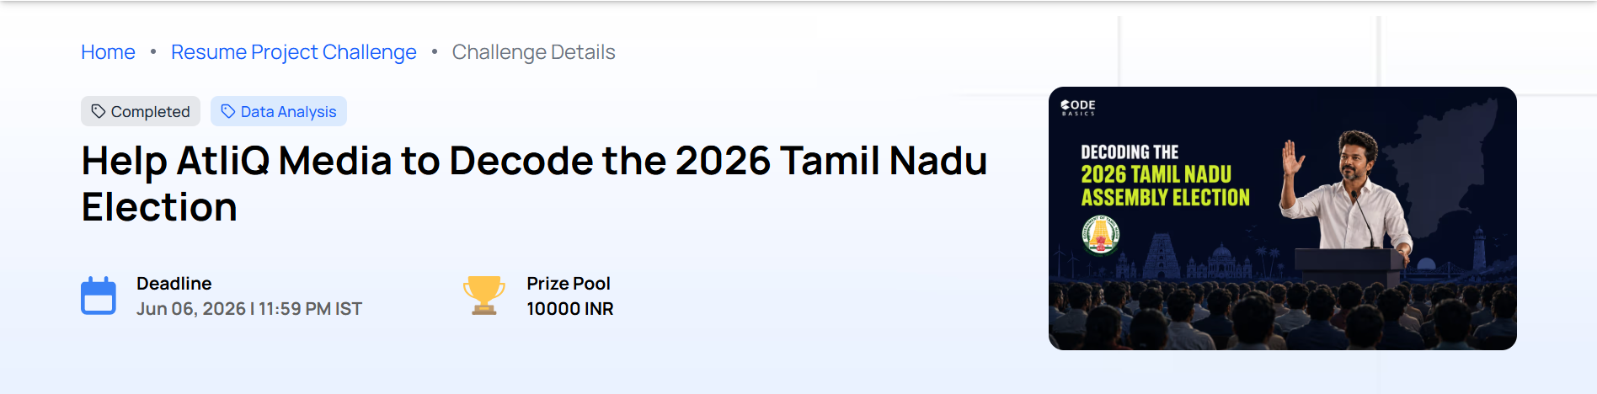
ATLIQ MEDIA — ELECTION ANALYSIS
The TVK Takeover
In 2026, Tamil Nadu saw a new party win big. TVK didn't just win — it cannibalized the vote banks of both DMK and AIADMK. The most competitive fights weren't in general seats. They were in reserved SC and ST constituencies — where nearly half the races were decided by less than 5%.

Slide 2
Headline Numbers
91
65
Seats Flipped to TVK
DMK → TVK
From DMK and AIADMK combined
Direct seat transfers
47.8%
119
Reserved Seats Under 5%
Constituencies Hit DMK
Decided by razor-thin margins
Where DMK lost highest vote share to TVK

Slide 3
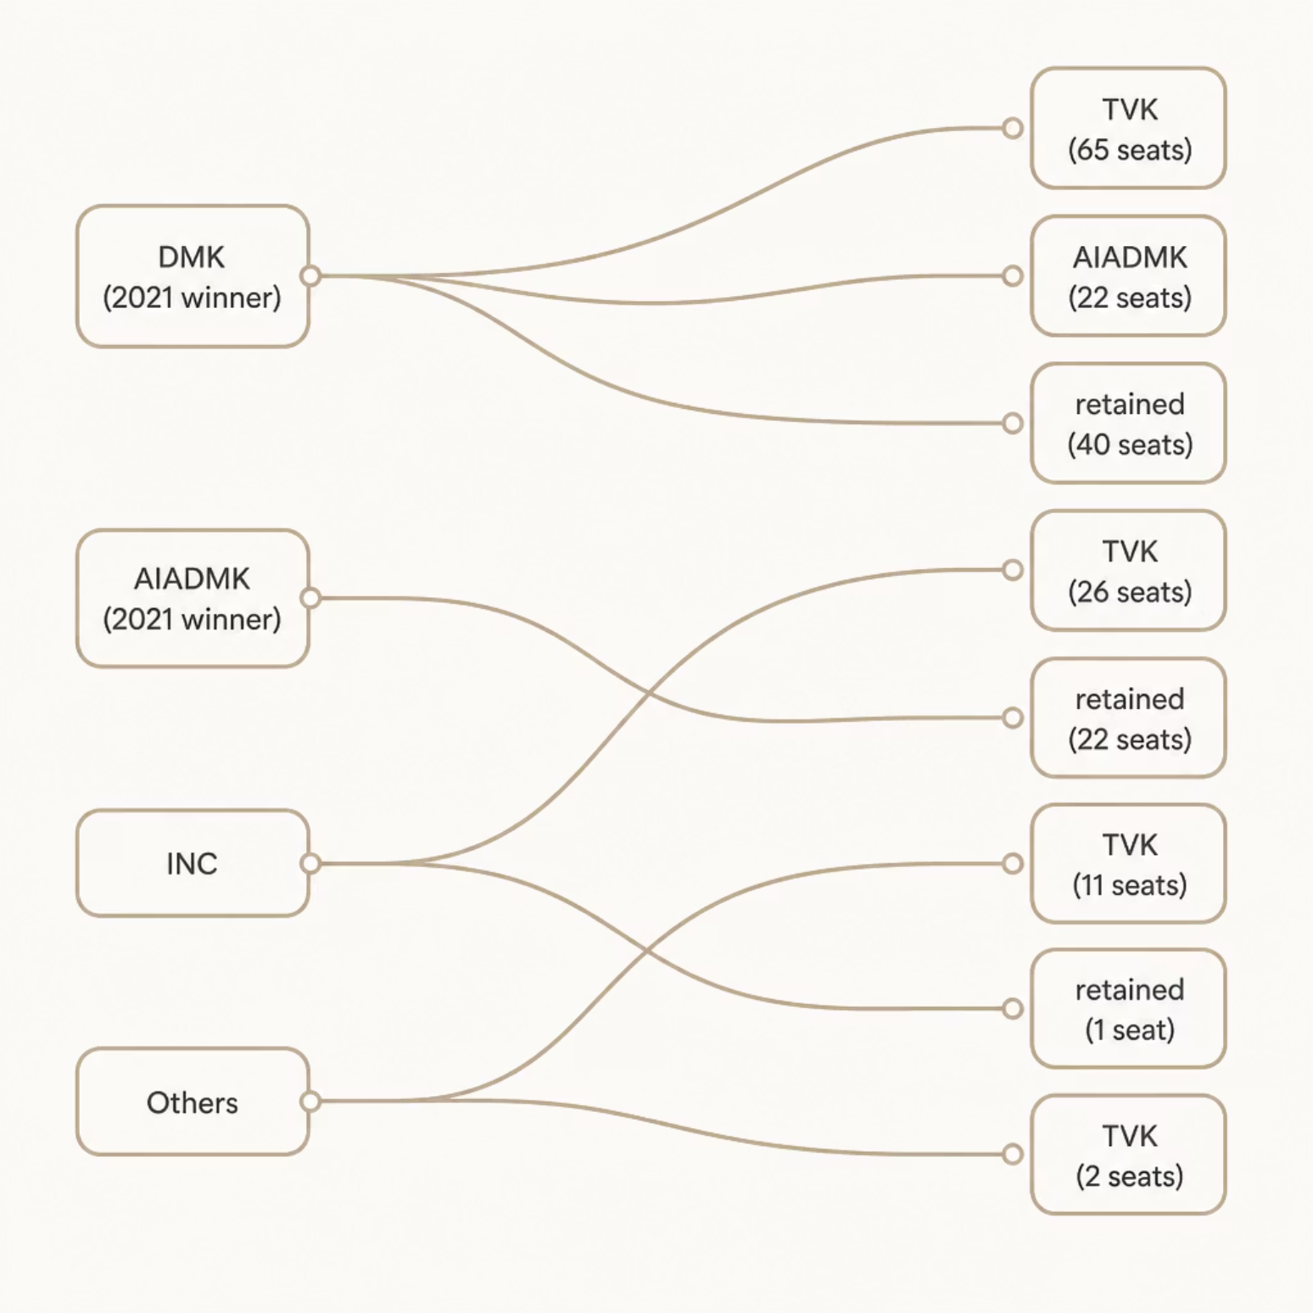
Q2: The Seat Flip Map
Where the Seats Went
DMK lost 65 seats directly to TVK — the single largest transfer. AIADMK lost 26. Together, 91 seats once held by the two major parties flipped to TVK.
DMK → TVK: 65 seats
AIADMK → TVK: 26 seats
INC → TVK: 11 seats
Others → TVK: 2 seats

Slide 4
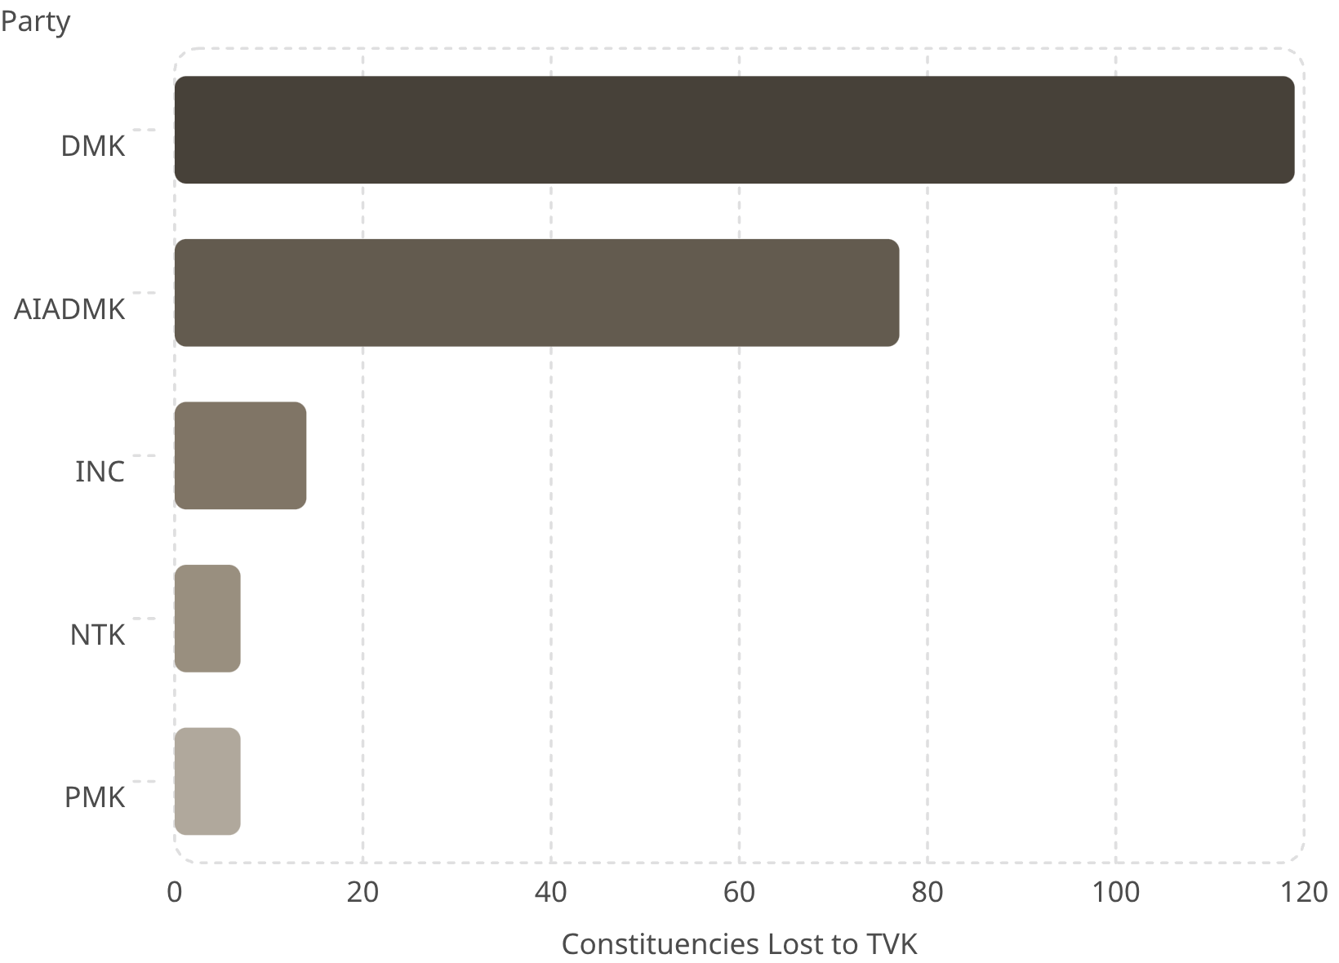
Q3: TVK's Vote Sources
Average Vote Share Loss to TVK
TVK didn't just win seats — it ate into the vote banks of both major parties across the state.
DMK: −16.9% across 119 constituencies
AIADMK: −15.9% across 77 constituencies
INC: −16.0% across 14 constituencies
PMK: −15.0% across 7 constituencies

Slide 5
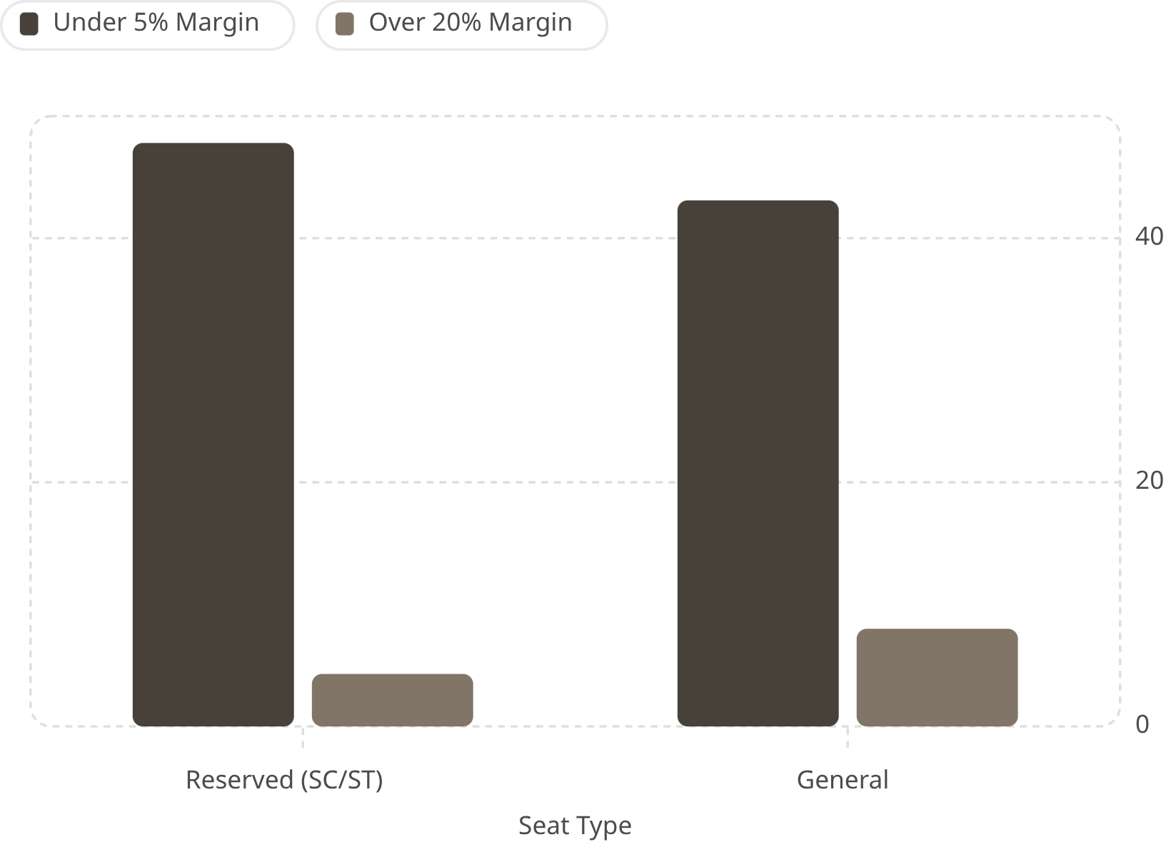
Q4: Reserved Seats — The Real Battleground
46 SC & ST Constituencies
Reserved seats are where elections are won or lost by a whisker.
47.8% of reserved seats decided by <5% — nearly 1 in 2
Only 43.1% of general seats that close
Landslide wins (>20% margin) are rarer in reserved seats: just 4.3% vs 8%

Slide 6
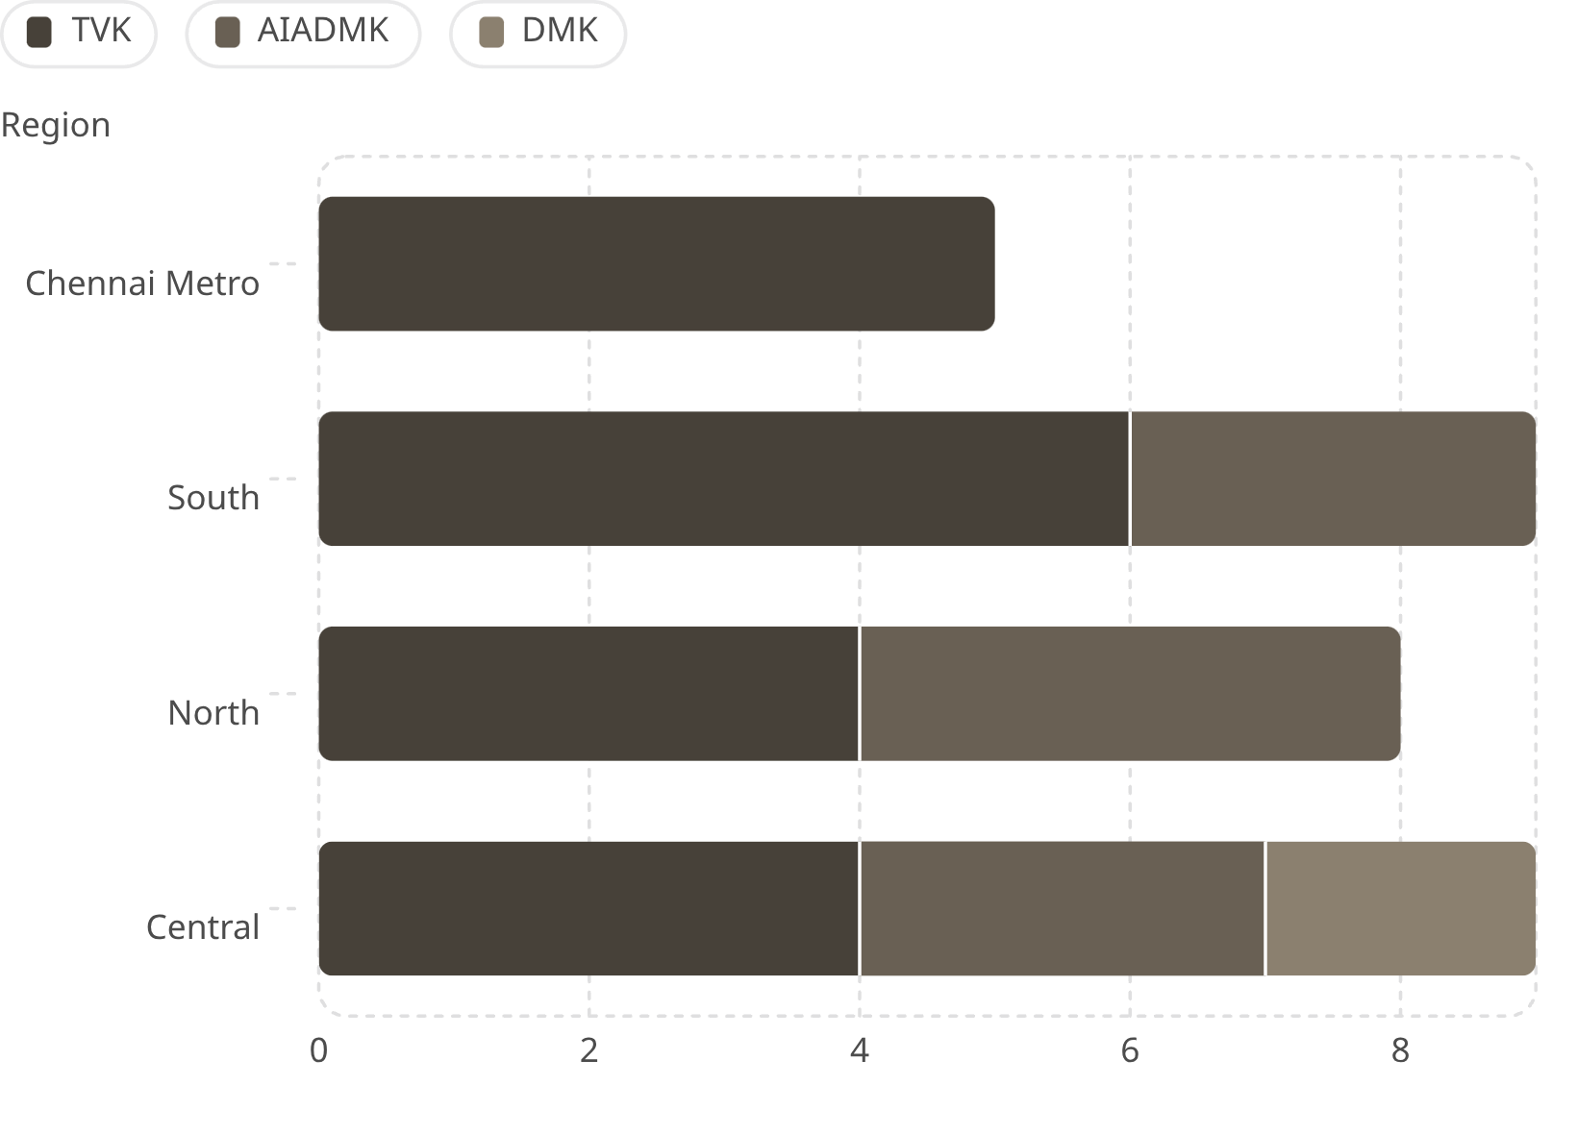
Q1: Reserved Seat Wins by Region
TVK Built Its Foundation on Reserved Seats
Chennai Metro: TVK swept all 5 reserved seats
South: TVK won 6 of 9 reserved seats
North: TVK tied AIADMK at 4 each
Central: Three-way fight — TVK 4, AIADMK 3, DMK 2

Slide 7

The Five Nail-Biters
These reserved seats could have flipped with just a few hundred votes.
Constituency
Region
Winner
Margin
Kallakurichi
Central
TVK
0.32% (~500 votes)
Tindivanam
Central
TVK
0.37%
Manamadurai
South
TVK
0.58%
Yercaud (ST)
Central
AIADMK
0.86%
Senthamangalam
Central
TVK
1.27%
Pattern: Four of five are in the Central region. Four of five were won by TVK.

Slide 8
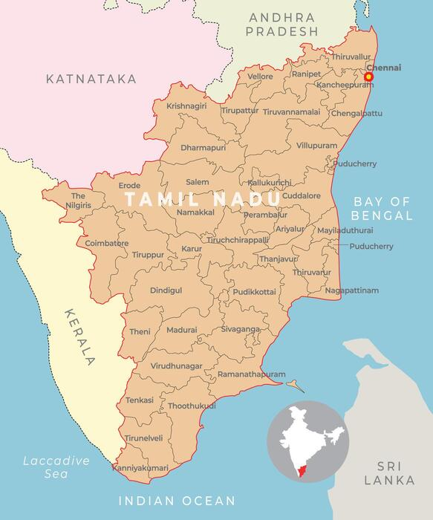
Central Region Deep Dive
4 of 5 Nail-Biters
Three-Way Fight
Four of the five closest reserved seats in the state are in the Central region — a concentrated pressure zone.
Central reserved seats split TVK 4, AIADMK 3, DMK 2 — the most contested region overall.
Reporter Priority
Send a reporter to Central region. Ask local leaders why the fight was so tight.

Slide 9
Thank You
Let's build fact-based television.
Reserved seats are Tamil Nadu's real swing seats — 47.8% decided by <5% margin
TVK's foundation was built on SC/ST constituencies, especially in Chennai Metro & South
Central region housed 4 of the 5 closest reserved seat races in the state
No causal claims — we report only what the data says
GitHub Repo: https://github.com/dee8864/Decoding-the-2026-Tamil-Nadu-Election |
Data: ECI Provisional Results |
Analysis: Python (pandas, matplotlib)

